Slide 1
Technical Presentation Rovers and other space technologies
ASHUTOSH BHARDWAJ 22BDS0219

Slide 2
Introduction
What is a rover
Main components of a rover of a rover

Slide 3
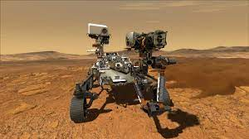
What is a mars rover

Slide 4
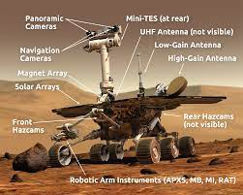
Important components of mars rover

Slide 5
Important components of mars rover
Remote Sensing Mast (RSM)
Power Source
Robot Arm
Antennas

Slide 6
Conclsion
Used to find if a planet is habitable for humans or rich in materials
Research of the universe

Slide 7
Thank You

